Slide 1
CLENV
The No. 1 waste management app
A Clean Tech Idea developed by
THE SOLUDEV TEAM
@
HACKATHON (HACKFEST 2.0)
On Sat. 8th October, 2022

Slide 2
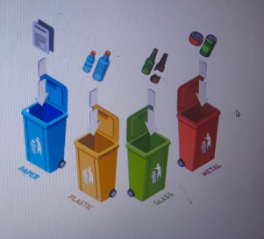
CONTENT
Stage One: Planning and research
Stage Two: Prototyping
Stage Three: Design
Stage Four: Development
Stage Five: Testing

Slide 3
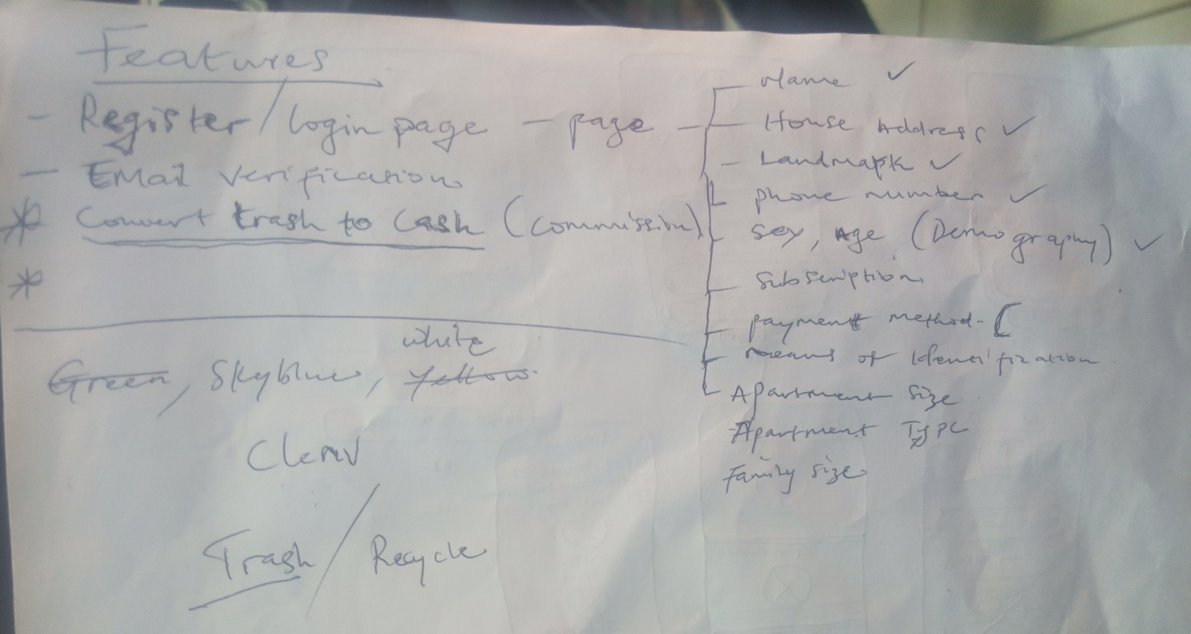
STAGE ONE:
PLANNING & RESEARCH

Slide 4
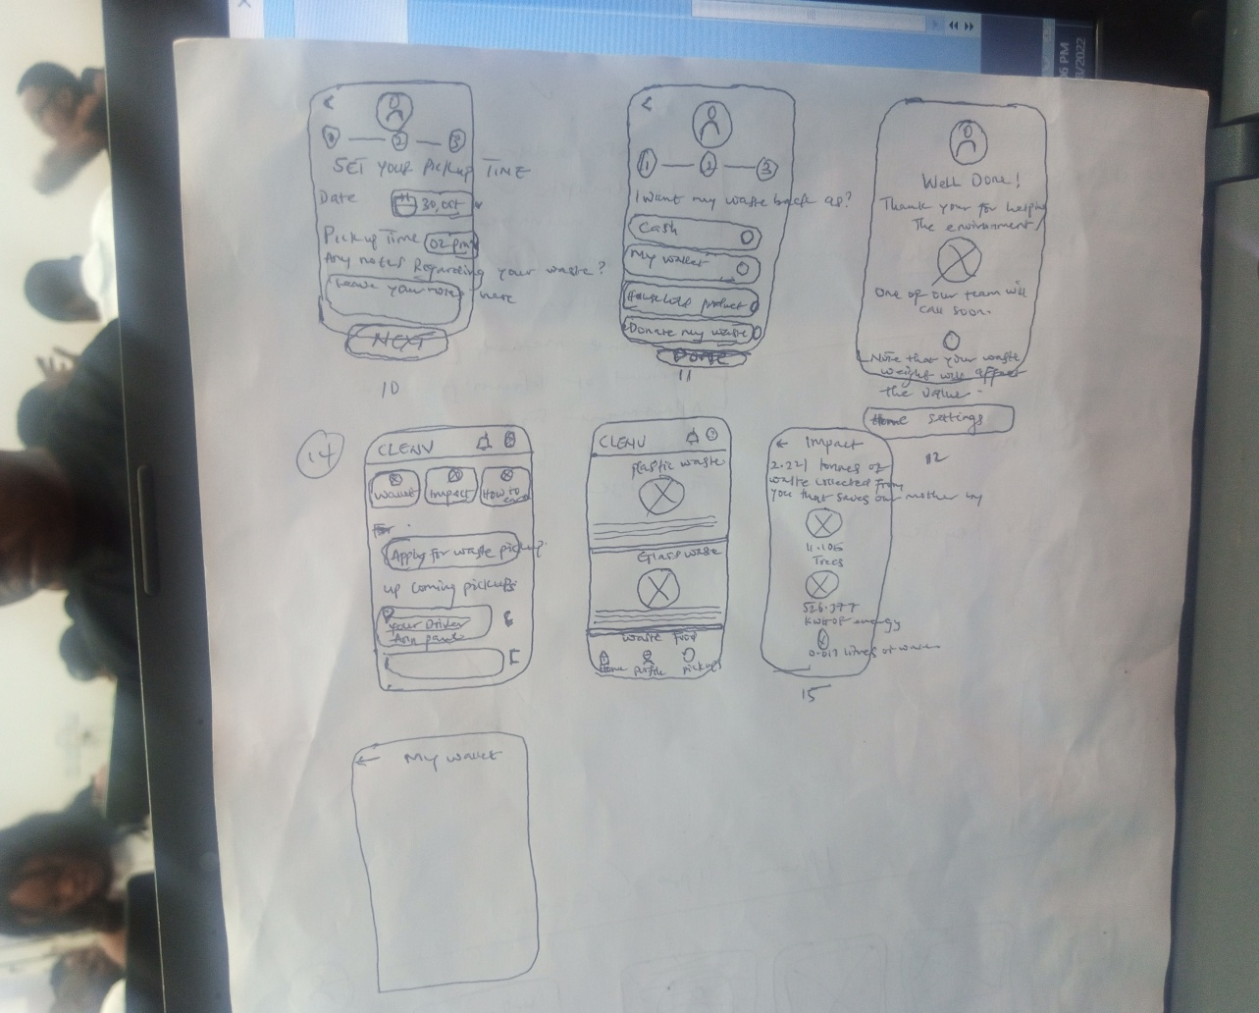
STAGE TWO:
PROTOTYPING

Slide 5
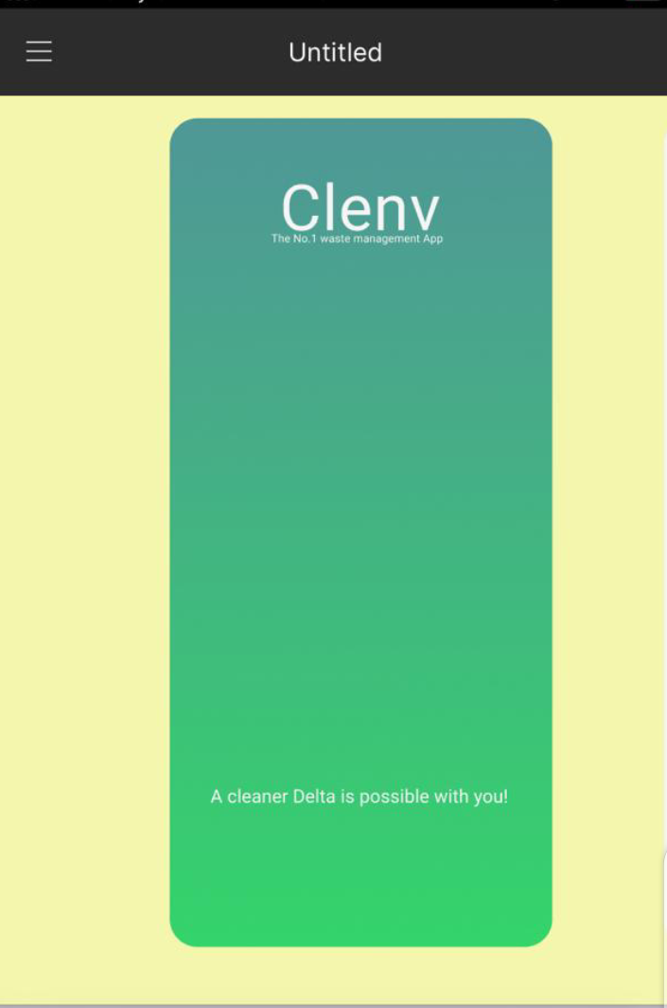
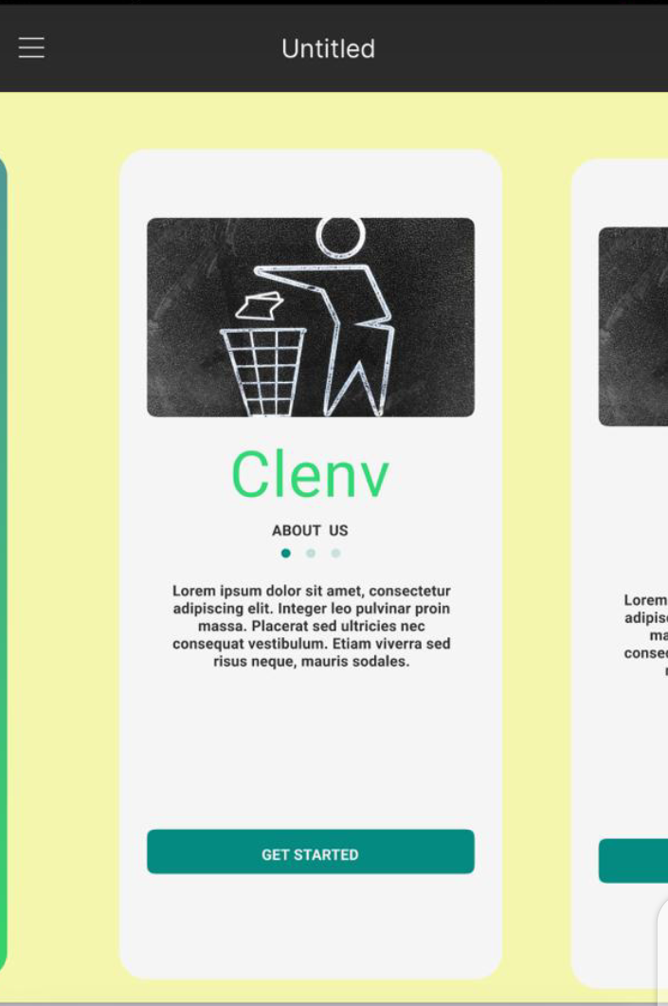
STAGE THREE:
DESIGN

Slide 6
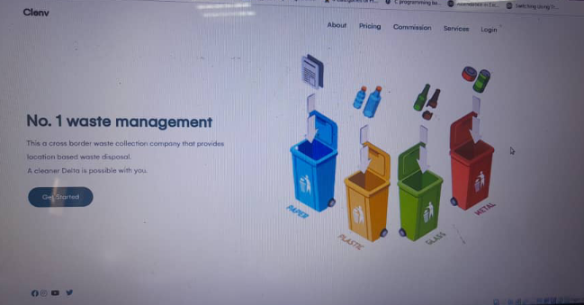
STAGE FOUR:
DEVELOPMENT

